Slide 1
FIFA WORLD CUP
BY : GAVIN DURAI

Slide 2
Welcome to the World Cup Dashboard Presentation!
On this journey through our World Cup Dashboard, we'll explore:
Introduction: A brief overview of the importance and scope of the dashboard.
Key Metrics: Insightful data and statistics on teams, players, and matches.
Visualizations: Engaging charts and graphs that bring the data to life.
Conclusion: Wrapping up with the significance of our insights for fans and stakeholders.
Let's dive into the excitement and analytics of the World Cup like never before!

Slide 3
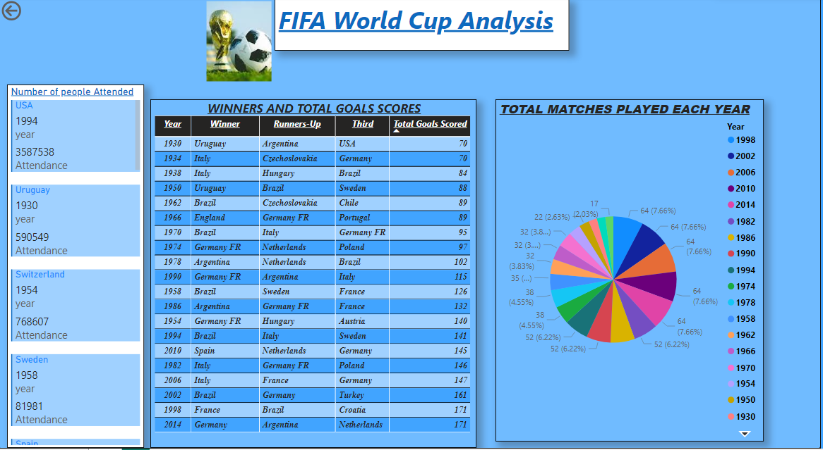

Slide 4
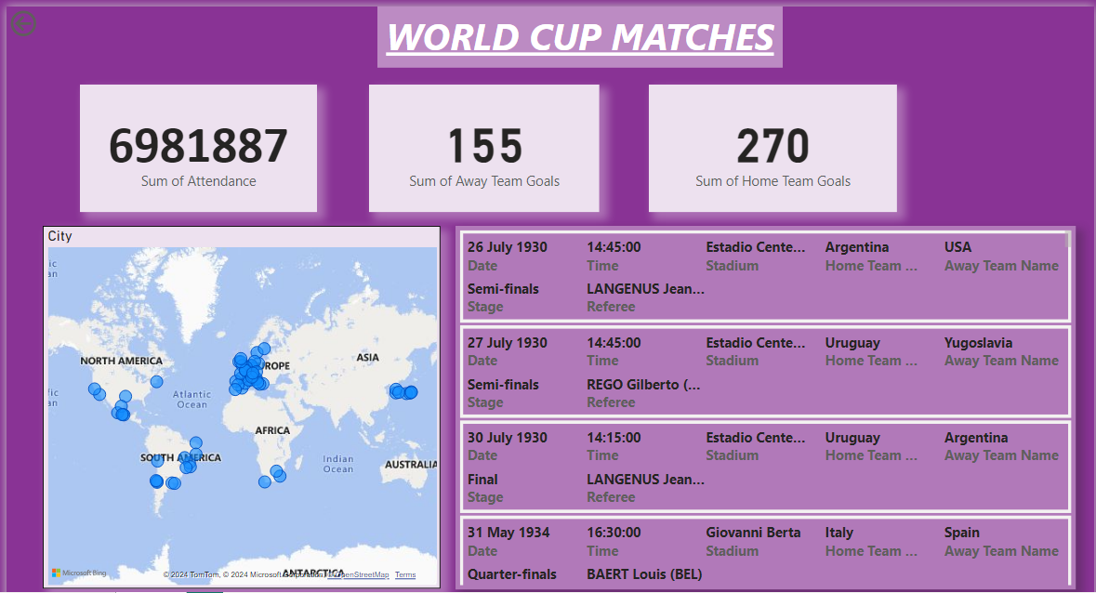

Slide 5
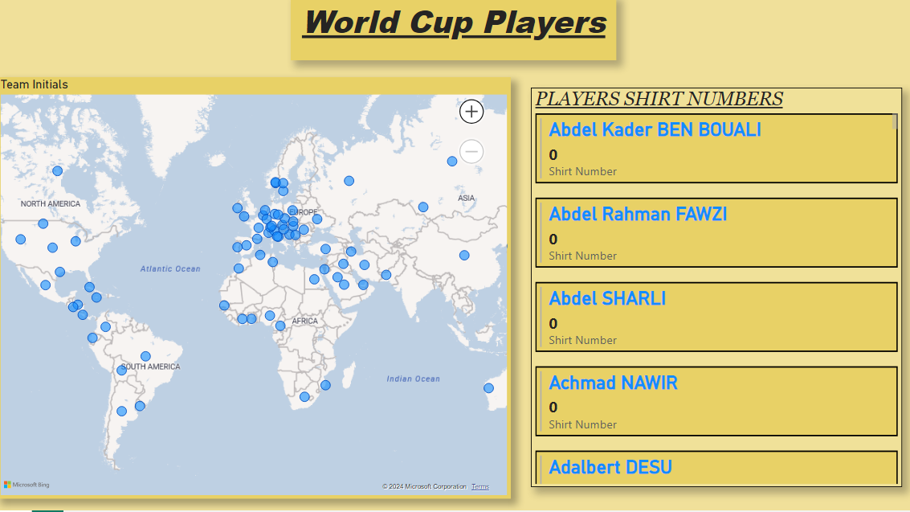

Slide 6

ABOUT THE FIFA WORLD CUP
The World Cup, is an international association football competition among the senior men's national teams of the members of the Fédération Internationale de Football Association (FIFA).
The tournament has been held every four years since the inaugural tournament in 1930, with the exception of 1942 and 1946 due to the Second World War.
The World Cup is the most prestigious association football tournament in the world, as well as the most widely viewed and followed single sporting event in the world.
Seventeen countries have hosted the World Cup, most recently Qatar, who hosted the 2022 event.
FIFA's VISION IS TO MAKE FOOTBALL TRULY GLOBAL, DIVERSE AND INCLUSIVE, FOR THE BENEFIT OF THE ENTIRE WORLD.

Slide 7
THANK YOU!

